Slide 1
HL ONLY
TOPIC B4:
ABSTRACT DATA TYPES
LESSON B4-5
PRINCIPLES OF ADTS

Slide 2

AGENDA
Hash Tables
Hash Table Programming
Collision Factors
Load Factors
Rehashing
Chaining
Open Addressing
WHAT U NEED 4 LESSON
Pycharm
Notes Document

Slide 3

THE WARM UP QUESTION
Construct a Binary Search Tree from the following names and tell me what the preorder and postorder traversal outputs are:
John, Jamie, Josh, Joey, Jerry, Jerome, Jack, Jaul

Slide 4



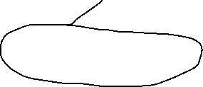










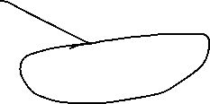

THE WARM UP ANSWER

Slide 5
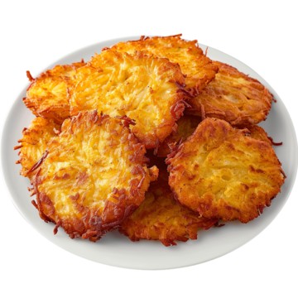
HASH TABLES
Hash tables are an incredibly important data structure in Computer Science
They are incredibly quick to insert into and get information from
They are structured similarly to arrays
Not lists, arrays
This means that they don’t have to hop nodes to find data, they can instantly access it at any spot

Slide 6
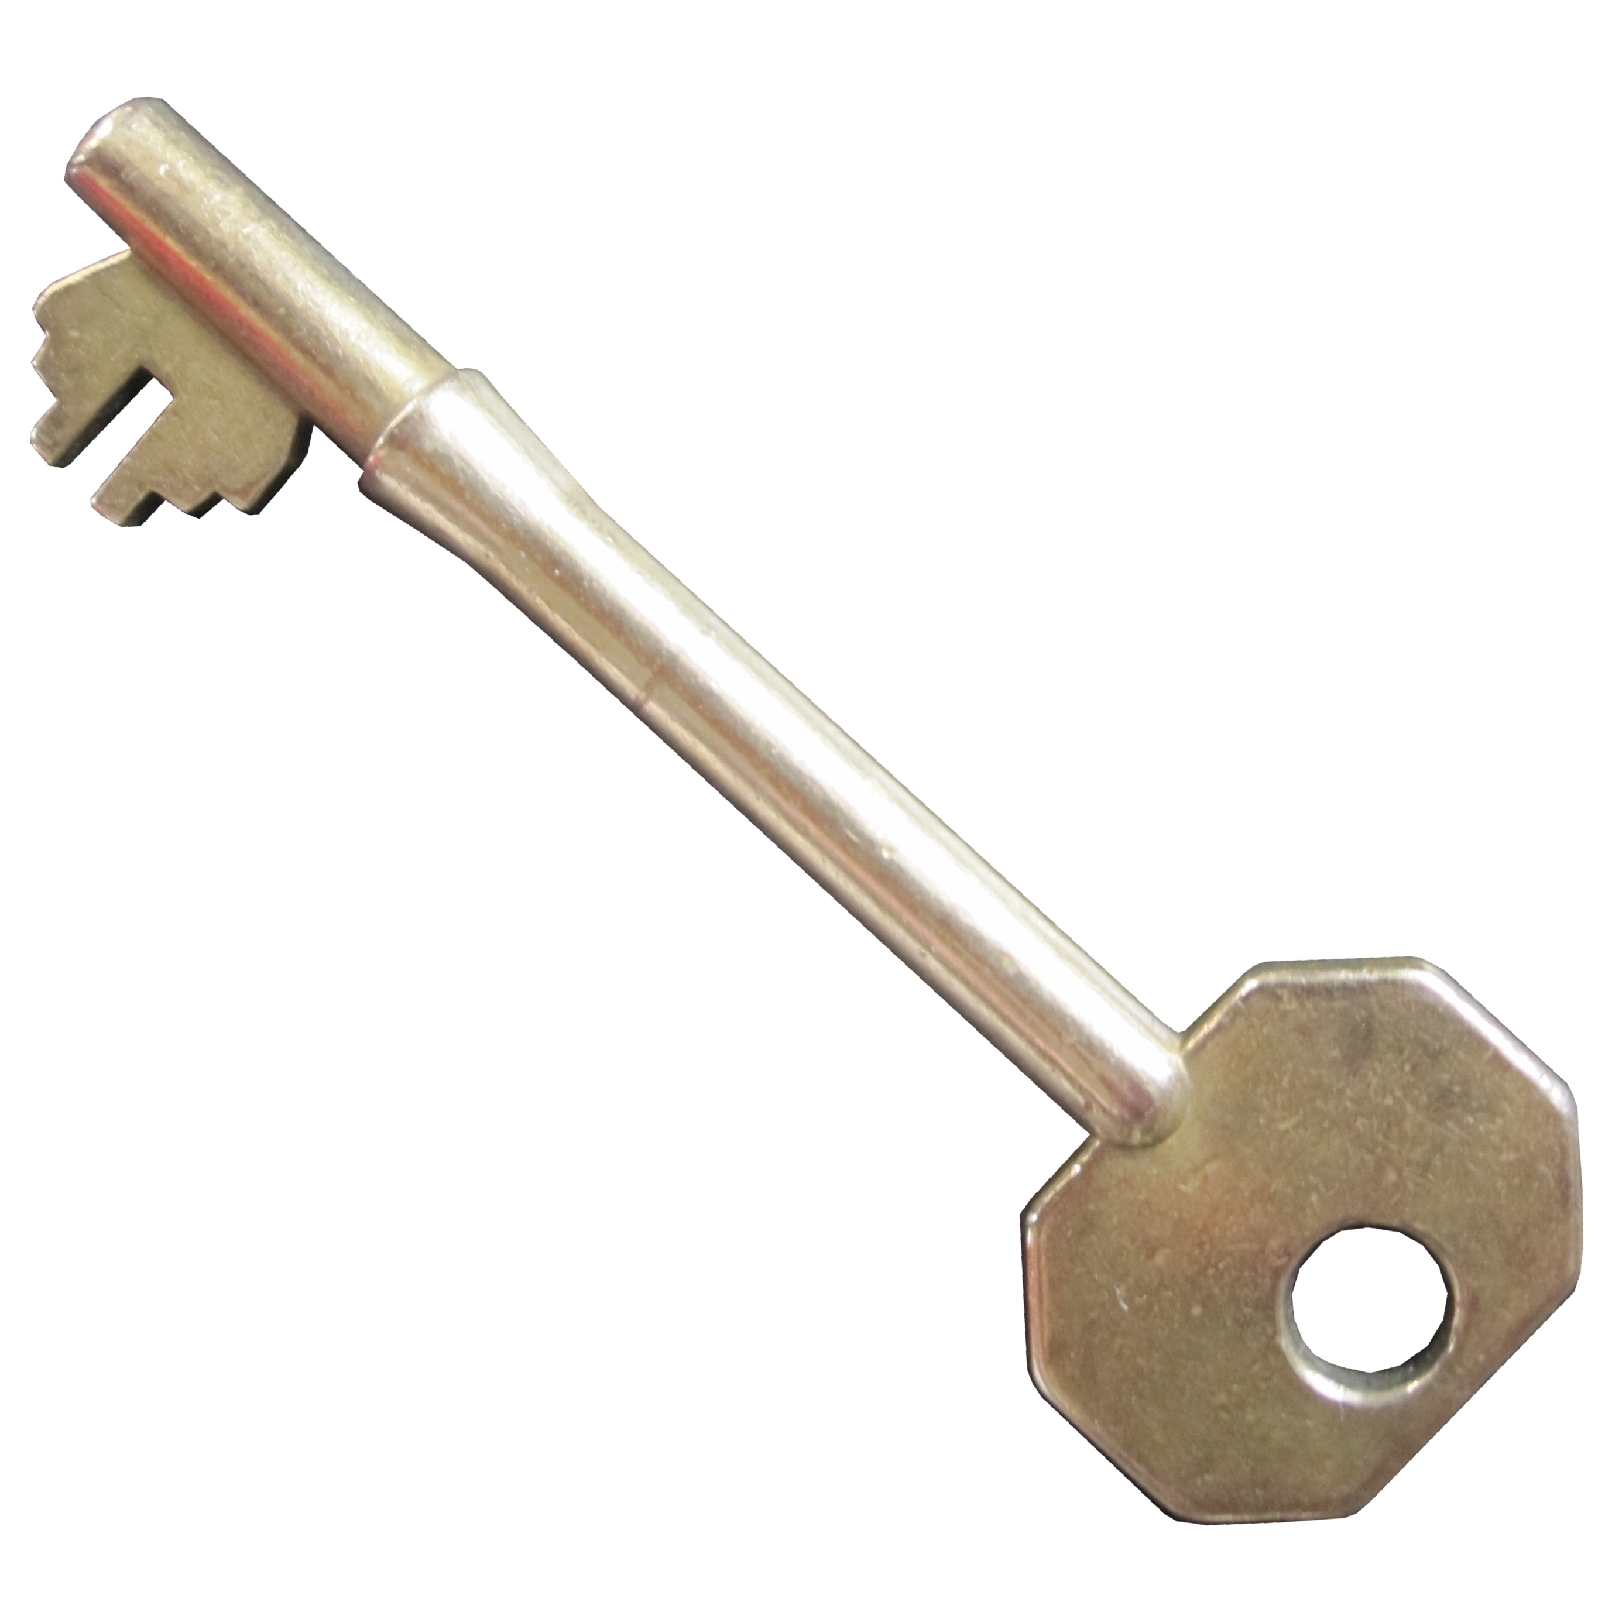
HASH TABLES
Rather than being indexed, data is accessed by keys
What data structure is this similar to?

Slide 7
HASH TABLES
Yeah, that is similar to a dictionary
That’s because Python’s dictionary IS an implementation of a hash table!
Built in!

Slide 8
HASH TABLES
The key that you provide is processed through a hashing algorithm to find which table index to store the data in
The table still has indexes, but you cannot access them directly
Let’s look at how this works

Slide 9

HASH TABLES
Let’s say I want to hash some strings into my hash table
For this example, my hash table will be 10 items long
So, we need an algorithm that can convert my string into an integer with a value from 0-9, and will do it the same way every time
Any thoughts?
INPUT
A string
PROCESS
???
OUTPUT
A number 0-9

Slide 10
HASH TABLES
Let’s break it down
INPUT
A string
PROCESS
???
OUTPUT
A number 0-9

Slide 11
HASH TABLES
Let’s break it down
There are likely multiple ways to approach this, but here’s mine
First, how do we even get a string to become a number?
INPUT
A string
PROCESS
???
OUTPUT
A number 0-9

Slide 12
HASH TABLES
We can convert a string to a number by using ASCII
We take the values of every letter in ASCII, and add them up
This gives us one number!
We’re so close!
Let’s do this for the string “FEET”
INPUT
A string
PROCESS
???
OUTPUT
A number 0-9

Slide 13
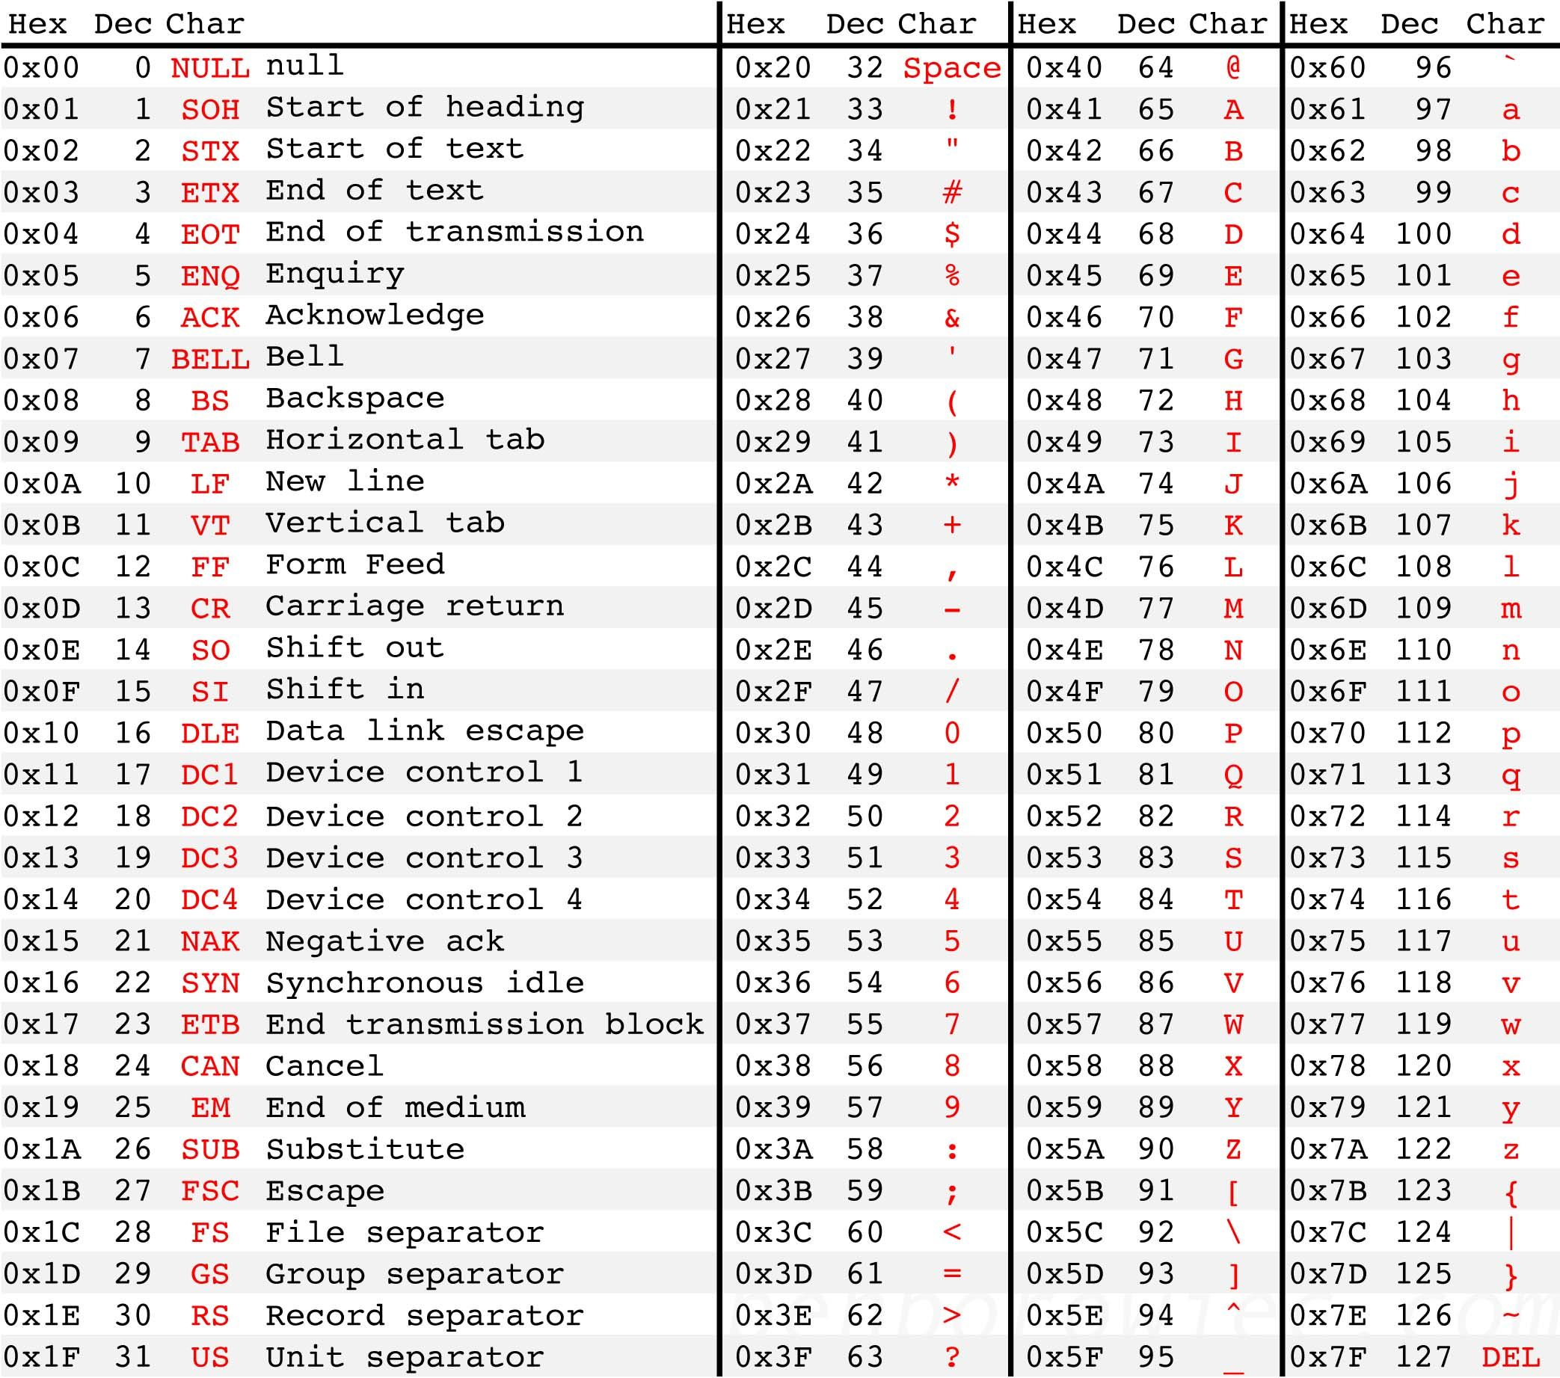
HASH TABLES
“FEET” =
INPUT
A string
PROCESS
???
OUTPUT
A number 0-9

Slide 14
HASH TABLES
“FEET” = 70 + 69 + 69 + 84
= 292
INPUT
A string
PROCESS
???
OUTPUT
A number 0-9

Slide 15
HASH TABLES
Now we have a number, 292
How can we convert this to be an integer from 0-9?
INPUT
A string
PROCESS
???
OUTPUT
A number 0-9

Slide 16
HASH TABLES
We can use modulo, in this case by 10, but generally the size of the table, to decide which slot it goes into
292 % 10 = 2
INPUT
A string
PROCESS
???
OUTPUT
A number 0-9

Slide 17
HASH TABLES
With that, we know, using this algorithm, FEET will go in the third slot of the hash table
INPUT
A string
PROCESS
ASCII + MOD
OUTPUT
A number 0-9

Slide 18
HASH TABLES
#Creating a hash table hash_table = {} #adding 2 items by key to the hash table hash_table["key1"] = "value1" hash_table["key2"] = 'value2' #getting the value for key1 value = hash_table["key1"] print("The value for 'key1' is :", value) #deleting a key from the hash table del hash_table["key2"] print(hash_table)
Let’s create a hash table in Python! (a.k.a a dictionary)

Slide 19
HASH TABLES
#Creating a hash table hash_table = {} #adding 2 items by key to the hash table hash_table["key1"] = "value1" hash_table["key2"] = 'value2' #getting the value for key1 value = hash_table["key1"] print("The value for 'key1' is :", value) #deleting a key from the hash table del hash_table["key2"] print(hash_table)
This is literally just a dictionary
One of the strangest things to me personally is the syntax for deleting an item
Just feels so strange

Slide 20
COLLISION FACTORS
Determine what slot the string “TOE” will go into

Slide 21
COLLISION FACTORS
What’s a potential problem with the current understanding we have of hash tables?
Especially related to the number of spots

Slide 22
COLLISION FACTORS
Collisions occur whenever two elements are trying to be stored in the same place
This is actually a problem that we still don’t have a total solution for, but we have two pretty good band-aid fixes
Chaining
Open Addressing

Slide 23
LOAD FACTOR
The numerical metric we use to determine how full a hash table is:
Load factor = number of elements in the table/total number of slots
How high the load factor is will heavily impact the performance of the hash table
If the load factor is high, it will have many more collisions, making the hash table slower

Slide 24
REHASHING
If the load factor exceeds a certain threshold, rehashing may be used to maintain efficiency
Rehashing creates a new, larger hash table, and redistributes the values
This would mean the modulo we use would get larger
This helps to reduce the load factor and increase efficiency

Slide 25
REHASHING
Steps:
Monitor load factor, trigger rehashing if it exceeds 0.7
Prepare a new hash table array that’s (at least) double the size of the current one. Ideally, a prime number helps to reduce collisions
For each element already in the hash table, re-compute the answer based on the new hash table size
Insert the elements into the new, larger hash table

Slide 26
CHAINING
If we still need to store multiple items in one hash spot, we can use chaining
Chaining uses linked lists to store more than one item at a single index
When a collision occurs, the new key-value pair is added to the end of a list at that index

Slide 27
CHAINING
Let’s look at an example of a 6 lengthed hash table, adding values of 35, 800, 82, 92, 122, 94
0
1
2
3
4
5

Slide 28
CHAINING
Let’s look at an example of a 6 lengthed hash table, adding values of 35, 800, 82, 92, 122, 94
0
1
2 | 800 | 92 | 122
3
4 | 82 | 94
5 | 35

Slide 29
CHAINING
Advantages:
Simplicity
Handles high load factors well, but lookup times become higher. Can even store more data than there is slots in the hash table
Good for unknown data sizes

Slide 30
CHAINING
Disadvantages:
Memory Overhead – linked lists take up more space
Deletion complexity – deleting an element means linked list deletion will need to be performed
Performance – much slower

Slide 31
OPEN ADDRESSING
Open addressing does not use anything except the hash table itself
When a collision occurs, it will find another empty slot in the hash table according to a predefined sequence, and store the data there
How do we do this? Propose an idea for how to do it

Slide 32
OPEN ADDRESSING
Approaches to open addressing:
Linear probing: if a spot is full, check the next spot until a space is found
This can lead to clustering, increasing the search time for adjacent elements

Slide 33
OPEN ADDRESSING
Approaches to open addressing:
Quadratic probing: searches in a more spaced out manner using a quadratic function until it finds a place
Double hashing: uses a second hash function to determine next probe step
The second hash function will offset the first one, requiring more computational overhead

Slide 34
OPEN ADDRESSING
Advantages:
Space efficient – uses no more space than the hash table would normally
Memory efficient – no pointers required
Simple to serialize – easier to save/load than chaining
Disadvantages
More computational overhead – more calculations
Clustering – especially in linear probing
Complex deletion – may have to check multiple spots

Slide 35
LVB
Using a hash table, write a system simulates voting
Add the names of all candidates at the start
Then loop, allowing users to type the name of the candidate they’d like to vote for
Allow users to type the word ‘end’ to end the program
When the program ends, output the number of votes each candidate recieved

Slide 36

VOCABULARY TO REMEMBER
Set
Intersection
Difference
Union
Subset
Superset

